Slide 1


International Symposium on Clustering as a Window on the Hierarchical Structure of Quantum Systems
Universal optical response for Feshbach molecules
Munekazu Horikoshi
Osaka City University, NITEP
Jun Kobayashi
( Experimental collaborator )
Kyoto University
Pascal Naidon
( Theoretical collaborator )
RIKEN
2020/1/23,24@Beppu
Notes:
I’m Munekazu Horikoshi from Osaka City University.
Today, I’ll talk about an experimental study of universal optical response for Feshbach molecules.
An experimental collaborator is Jun Kobayashi of Kyoto University.

Slide 2
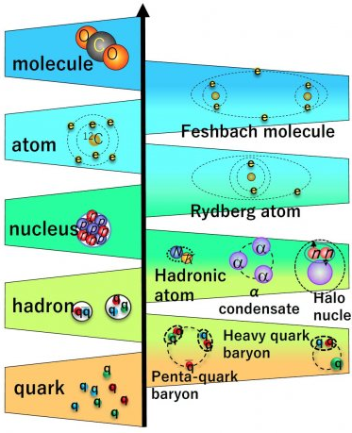


















Background : Resonant scattering processes in Semi-hierarchies
Conventional
hierarchies
Semi-
hierarchies
Shape resonance
Feshbach resonance
(Two channel coupling)
Ikeda threshold rule
$$E_{0}\sim E_{b}$$
$$E_{0}\sim E_{b}^{′}$$
$$E_{0}\sim E^{∗}$$
n-p (bound)
n-n (unbound)
cold atoms
Λ(1405)
α-cluster
$$E$$
$$E$$
$$E$$
Unbound
$$a<0$$
Close channel
$$E^{∗}$$
$$|e>$$
$$E_{0}$$
$$d$$
$$E_{0}$$
$$d$$
$$E_{0}$$
$$d$$
$$E_{b}$$
$$E_{b}^{′}$$
Open channel
Bound
$$a>0$$
$$|g>$$
Notes:
In various quantum systems, resonant scattering processes sometimes occur, for example, under the conditions of shape resonance, Feshbach resonance, and Ikeda threshold rule.
As a result, scattering particles have a scattering length larger than the interaction range.

Slide 3
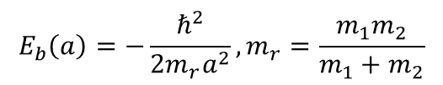
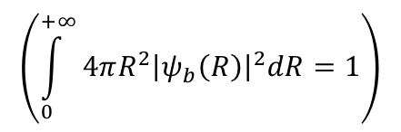
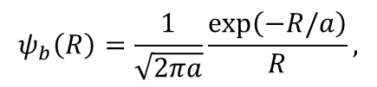
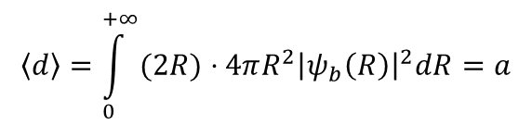

Universal dimers with a large scattering length
Positive scattering length $a>0$ with the attractive interaction potential
$$T<\left|E_{b}\right|$$
They can form a universal dimer :
Binding energy :
$$E_{b}\left(a\right)=−\frac{ℏ^{2}}{{2m}_{r}a^{2}},m_{r}=\frac{m_{1}m_{2}}{m_{1}+m_{2}}$$
$$ψ_{b}\left(R\right)=\frac{1}{\sqrt{2πa}}\frac{\exp\left(−R/a\right)}{R},$$
$$\left(\int_{0}^{+∞}{4πR^{2}{\left|ψ_{b}\left(R\right)\right|}^{2}dR}=1\right)$$
Wavefunction :
$$\left\langle d\right\rangle =\int_{0}^{+∞}{(2R)⋅4πR^{2}{\left|ψ_{b}\left(R\right)\right|}^{2}dR}=a$$
Mean diameter :
Notes:
One of the quantum cluster is universal dimers bounded by a large scattering length.
Particles which have positive scattering length with the attractive interaction potential can form a universal dimer when the temperature is lower than the absolute value of the binding energy.
Their binding energy and the wavefunction are given by the scattering length, and the mean diameter of the dimers are equal to the scattering length.

Slide 4




This study : Optical response for the universal dimers
Question : How the optical response changes?
What is the condition we can probe the cluster?
Energy
Excited state
$$ω_{1}$$
$$ω_{2}$$
$$ω_{mol}$$
$E_{1}$ transition
Ground state
Free particles
Loosely-bound particles
Tightly-bound particles
Notes:
In this study, we investigate optical response for the universal dimers.
Here, we consider particles which are allowed to E1 transition by electro-magnetic field.
When the particles are unbound, they are excited individually at each resonant frequency.
On the other hand, When the particles are bound tightly, the dimer is excited to the excited dimers by the bound-bound transition.
The question is how the optical response changes when the ground state changes from free particles to the tightly-bound particles gradually.
And, what is the condition we can probe the cluster?
These questions are fundamental questions for various quantum systems.

Slide 5






Feshbach molecules formed by ultracold ⁶Li atoms
Electric ground states
Feshbach resonances of ⁶Li atoms
10000
1.0
|3> = |m_{J}=-1/2, m_{I}=-1>, |m_{F}=-3/2>
8000
0.8
1000
|2> = |m_{J}=-1/2, m_{I}=0>, |m_{F}=-1/2>
|1> = |m_{J}=-1/2, m_{I}=+1>, |m_{F}=1/2>
6000
|12>
0.6
4000
|13>
0.4
500
|23>
2s
2000
0.2
e
1s
$$B_{0}^{13}$$
$$B_{0}^{23}$$
$$B_{0}^{12}$$
Energy shift : $ΔE$ [MHz]
↑
0
↓
↓
Scattering length [$a_{0}$]
Binding energy [MHz]
e
↑
↑
↑
0
0.0
↓
↓
↓
↓
↓
↑
↑
↑
↓
↑
e
-2000
-0.2
-500
⁶Li atoms
-4000
-0.4
-1000
-6000
-0.6
|3>
-8000
-0.8
|2>
0
200
400
600
800
1000
|1>
-10000
-1.0
600
700
800
900
Magnetic field : $B$ [Gauss]
Magnetic field [Gauss]
Universal dimers
(Feshbach molecules)
Notes:
In this study, we use ultracold ⁶Li atoms.
They have three internal states which have the Feshbach resonances, as shown in this figure.
We label 1,2,3 from the lowest state.
Since the three combinations of the internal states have different resonant magnetic fields and resonant widths,
it is a reasonable testing ground to study the optical response of the universal dimers at various conditions.

Slide 6
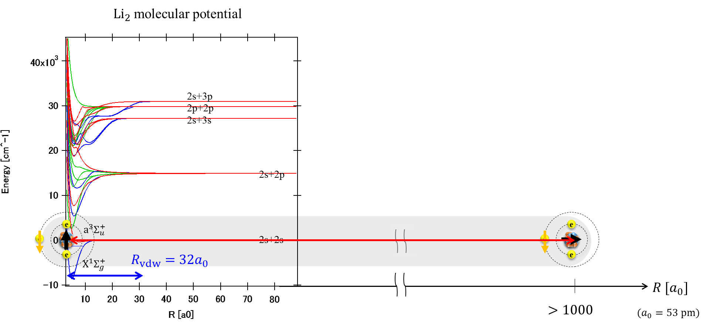

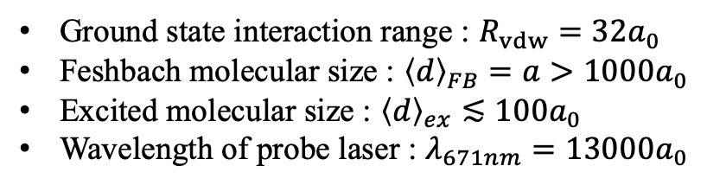




The length scales
Ground state interaction range : $R_{vdw}=32a_{0}$
Feshbach molecular size : ${\left\langle d\right\rangle }_{FB}=a>1000a_{0}$
Excited molecular size : ${\left\langle d\right\rangle }_{ex}≲100a_{0}$
Wavelength of probe laser : $λ_{671nm}=13000a_{0}$
$$R_{vdw}, {\left\langle d\right\rangle }_{ex}≪{\left\langle d\right\rangle }_{FB}\sim λ_{671nm}$$
$${\left\langle d\right\rangle }_{ex}<100a_{0}$$
$E_{1}$ transition
${\left\langle d\right\rangle }_{FB}=a$ (tunable)
$$λ_{671nm}=13000a_{0}$$
Notes:
In order to imagine the length scale of the Feshbach molecules of 6Li, I show you the molecular potential of Li₂.
The interaction range in the ground state is 32 Bohr radius.
However, the size of the Feshbach molecules are much much larger than the interaction range, because the size is equal to the scattering length.
The E1 transition correspond to 2s to 2p transition at the dissociation limit.

Slide 7





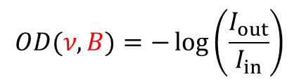
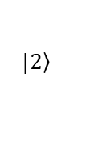

Experimental method
Absorption spectroscopy
$$|\left.2\right\rangle$$
$$|\left.1\right\rangle$$
$$|\left.1\right\rangle$$
$$|\left.1\right\rangle$$
Feshbach molecules
$$I_{in}(ν)$$
$$|\left.2\right\rangle$$
$$I_{out}(ν)$$
$$|\left.2\right\rangle$$
$$|\left.1\right\rangle$$
$$|\left.2\right\rangle$$
$${\left\langle d\right\rangle }_{FB}=a(B)$$
$$|\left.1\right\rangle$$
$$|\left.2\right\rangle$$
$$|\left.2\right\rangle$$
$$|\left.1\right\rangle$$
Free atoms
$$I_{in}(ν)$$
$$|\left.1\right\rangle$$
$$|\left.1\right\rangle$$
$$I_{out}(ν)$$
$$|\left.2\right\rangle$$
$$|\left.2\right\rangle$$
$$|\left.1\right\rangle$$
$$OD(ν,B)=−\log\left(\frac{I_{out}}{I_{in}}\right)$$
Optical density :
Notes:
The experimental method is absorption spectroscopy.
We prepare Feshbach molecules or free atoms and we apply a probe pulse.
Then we evaluate the optical density from the input and the output power as functions of the laser frequency and the applying magnetic field.

Slide 8
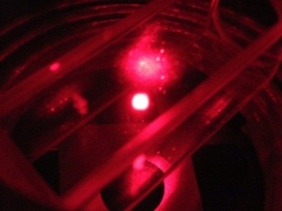
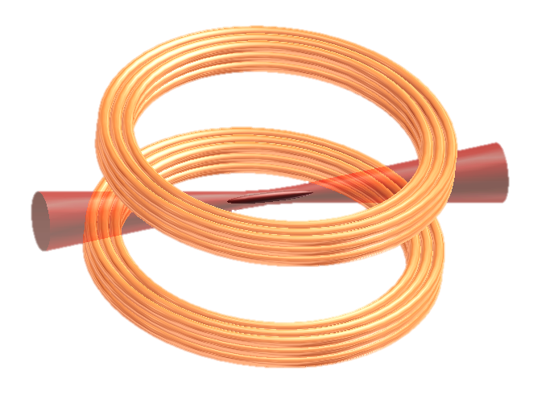



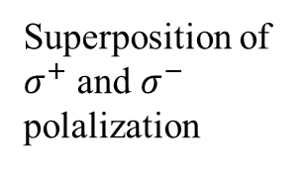



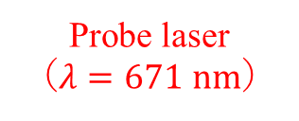
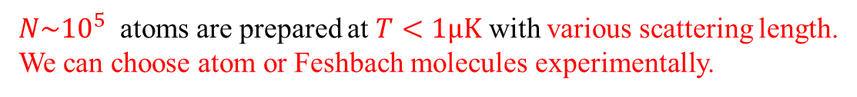

Experimental setup
Laser cooling of ⁶Li atoms
Confinement, state preparation, and evaporative cooling in an optical trap
$$B$$
A pair of Feshbach coils
Optical trap
Probe laser
（$λ=671$ $nm$）
$$I_{out}$$
CCD
camera
$$ν_{p}$$
$$I_{in}$$
Imaging lens
Superposition of $σ^{+}$ and $σ^{−}$ polalization
$$y$$
$$x$$
$$z$$
$N\sim {10}^{5}$ atoms are prepared at $T<1μK$ with various scattering length.
We can choose atom or Feshbach molecules experimentally.
Notes:
This is our experimental setup.
After laser cooling, cold 6Li atoms are confined in an optical trap, and state preparation and the evaporative cooling are applied.
The scattering length between atoms is controlled by a current of a pair of Feshbach coils.
We can choose atom or Feshbach molecules by choosing the evaporative cooling process.
In this way, ${10}^{5}$ of atoms are prepared at $T<1μK$ with various scattering length.
The probe laser is applied to the samples and the laser power is measured by a CCD camera.

Slide 9


Experiment1. Optical transition for the free atoms
$$|\left.1\right\rangle$$
$$|\left.2\right\rangle$$
$$|\left.2\right\rangle$$
$$|\left.1\right\rangle$$
Free atoms
$$I_{in}(ν)$$
$$|\left.1\right\rangle$$
$$|\left.1\right\rangle$$
$$I_{out}(ν)$$
$$|\left.2\right\rangle$$
$$|\left.2\right\rangle$$
$$|\left.1\right\rangle$$
Notes:
At first, I show you the normal optical transition for the free atoms.

Slide 10
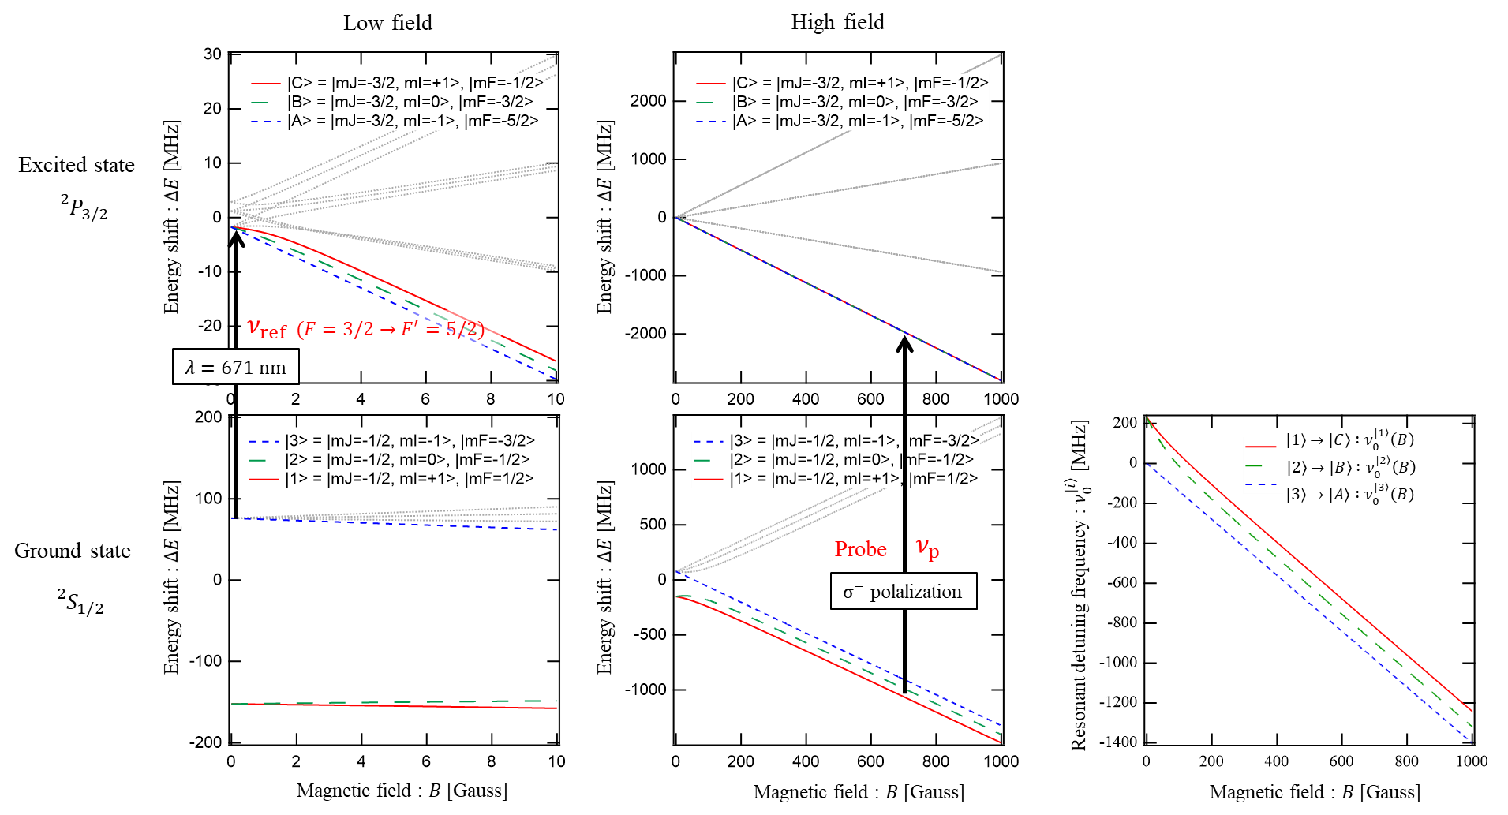

Optical transition of the free ⁶Li atoms in the Feshbach magnetic field
Detuning frequency from the reference transition line :
$$ν≡ν_{p}−ν_{ref}$$
The resonant frequencies
Notes:
These figure shows Zeeman the Zeeman shifts of the hyperfine magnetic sublevels of the ground states and the excited states.
The probe frequency is $ν_{p}$ with $σ^{−}$ polalization.
This $ν_{ref}$ is the reference laser frequency.
Here we define $ν$ as probe laser frequency from the reference transition line.
The resonant frequencies are shown in this figure for the states of |A>,|B>,|C> as a function of magnetic field.

Slide 11
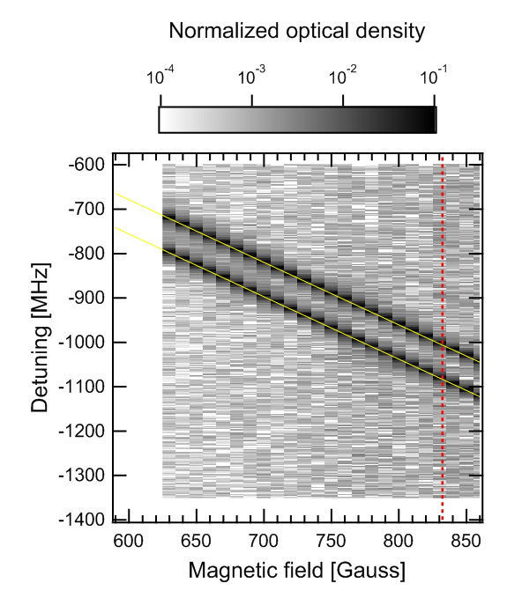
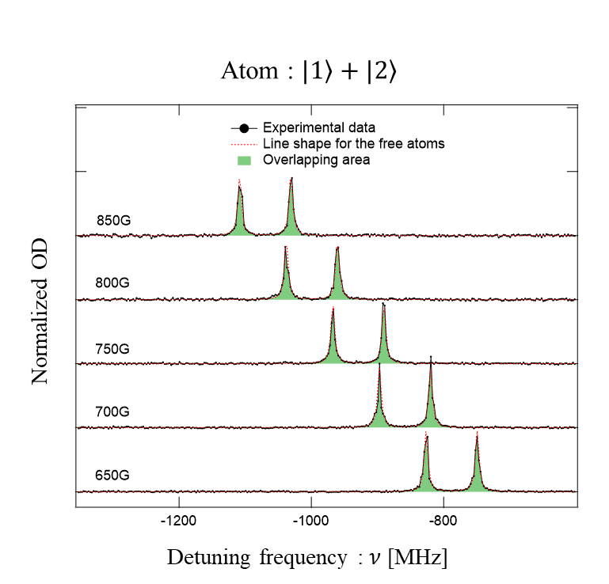
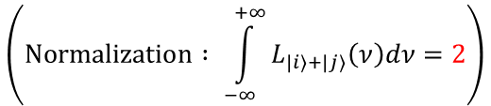
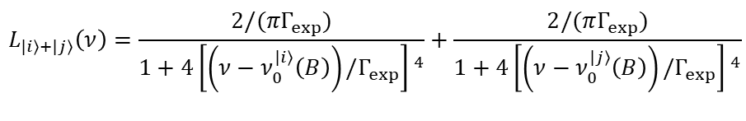

Optical transition of the free ⁶Li atoms in $\left.|1\right\rangle$and $\left.|2\right\rangle$in the magnetic field
$$B_{0}^{12}$$
$$L_{\left.|i\right\rangle +\left.|j\right\rangle }\left(ν\right)=\frac{2/(πΓ_{exp})}{1+4{\left[\left(ν−ν_{0}^{\left.|i\right\rangle }\left(B\right)\right)/Γ_{exp}\right] }^{4}}+\frac{2/(πΓ_{exp})}{1+4{\left[\left(ν−ν_{0}^{\left.|j\right\rangle }\left(B\right)\right)/Γ_{exp}\right] }^{4}}$$
$$\left(Normalization : \int_{−∞}^{+∞}{L_{\left.|i\right\rangle +\left.|j\right\rangle }\left(ν\right)dν}=2\right)$$
The line shape for the free two atoms :
(No fitting parameters)
$Γ_{exp}=6.75(3)$ MHz, (The natural line width of ⁶Li atom : $Γ_{0}=5.87$ MHz)
Notes:
This is the experimental result for the free atoms in $\left.|1\right\rangle$and $\left.|2\right\rangle$in the magnetic field.
The left figure shows two-dimensional spectral.
The horizontal axis is magnetic field, and the vertical axis is the detuning frequency.
The gray color shows optical density.
The yellow lines are calculated resonant frequencies.
The right figure shows five spectra at different magnetic fields.
The line shape is given by a two-lorentzian function, and the experimental data mach to the shape.
The observed width is close to the theoretical values.
This small difference can be explained by line width of the laser light.

Slide 12



Experiment2. Optical transition for the Feshbach molecules
$$|\left.2\right\rangle$$
$$|\left.1\right\rangle$$
$$|\left.1\right\rangle$$
$$|\left.1\right\rangle$$
Feshbach molecules
$$I_{in}(ν)$$
$$|\left.2\right\rangle$$
$$I_{out}(ν)$$
$$|\left.2\right\rangle$$
$$|\left.1\right\rangle$$
$$|\left.2\right\rangle$$
$${\left\langle d\right\rangle }_{FB}=a(B)$$
Notes:
Next, I show you the optical transition for the Feshbach molecules.

Slide 13
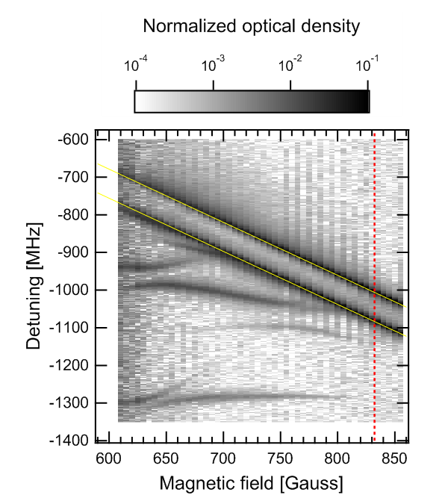
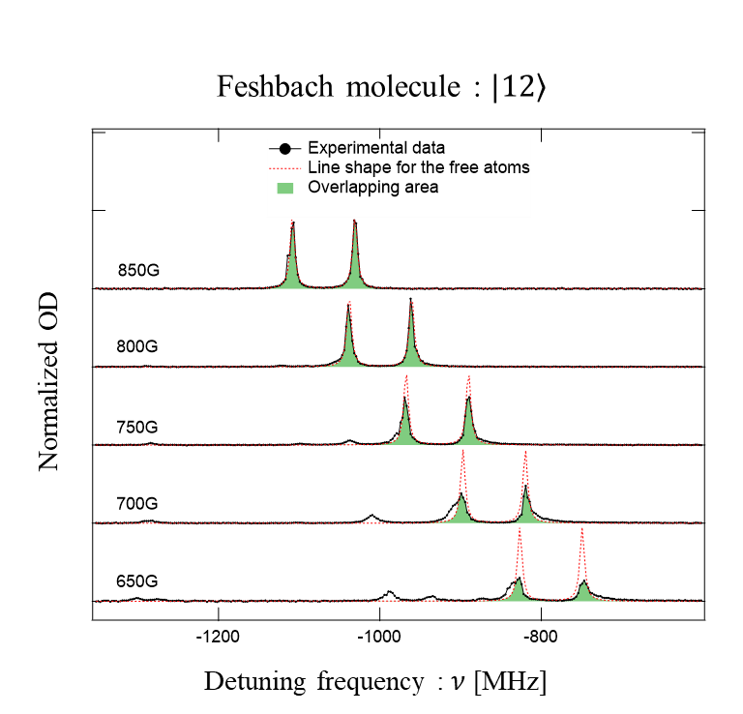

Optical transition of the Feshbach molecules of $\left.|12\right\rangle$in the magnetic field
$$B_{0}^{12}$$
large
size of the Feshbach molecule
small
The overlapping areas may have analogy to ‘particleness’ or ‘atomicness’ of Feshbach molecule as viewed from the laser light.
Notes:
The left figure shows the two-dimensional spectral.
The vertical red line shows the resonant Feshbach magnetic field.
We can see a lot of additional peaks bellow the yellow lines .
They correspond to the bound-to-bound transitions to the excited diatomic molecules.
The right figure shows five spectra at different magnetic fields.
The figure shows that the experimental data start to deviate from the line shape of the free atoms as the size of the Feshbach molecules become smaller.
The overlapping areas are shown by green color.
I think these overlapping areas have analogy to ‘particleness’ or ‘atomicness’ of Feshbach molecule as viewed from the laser light.

Slide 14







Overlapping ratio between experimental data and the line shape of the free atom
$$B_{0}^{13}$$
$$B_{0}^{23}$$
$$B_{0}^{12}$$
1.0
Feshbach resonances of ⁶Li atoms
10000
1.0
0.9
8000
0.8
0.8
6000
|12>
0.6
4000
|13>
0.4
|23>
0.7
2000
$$B_{0}^{13}$$
$$B_{0}^{23}$$
$$B_{0}^{12}$$
0.2
Overlap ratio
Scattering length [$a_{0}$]
Binding energy [MHz]
0.6
0
0.0
-2000
-0.2
0.5
Atom : |1> and |2>
-4000
-0.4
Mol : |12>
-6000
-0.6
0.4
Mol : |13>
Mol : |23>
-8000
-0.8
0.3
-10000
-1.0
600
650
700
750
800
850
600
700
800
900
Magnetic field [Gauss]
Magnetic field [Gauss]
Notes:
We evaluated the overlapping ratio for the other Feshbach molecules.
This figure shows the result.
The open circles indicate data for the unbound atoms in the states of |1> and \2>.
The offset from 1 is due to the experimental noise.
The filled circles, squares, triangles are data for Feshbach molecules of |12>, |13>, and |23>, respectively.
They show different magnetic field dependence, but it looks that they have some correlation to their Feshbach resonances.

Slide 15

Overlapping ratio between experimental data and the line shape of the free atom
$$B_{0}^{13}$$
$$B_{0}^{23}$$
$$B_{0}^{12}$$
1.0
1.0
0.9
0.9
0.8
0.8
0.7
0.7
Overlap ratio
Overlap ratio
0.6
0.6
Atom : |1> and |2>
Mol : |12>
0.5
Atom : |1> and |2>
0.5
Mol : |13>
Mol : |12>
Mol : |23>
0.4
Mol : |13>
0.4
Mol : |23>
0.3
0.3
600
650
700
750
800
850
2
4
6
8
2
4
6
8
2
4
6
8
2
0.1
1
10
Magnetic field [Gauss]
$$a/λ$$
Notes:
By changing the horizontal axis from magnetic field to the scattering length devided by the wavelength of the probe laser,
These three data series show a universal curve and those values start to decrease where the scattering length becomes smaller than the wavelength.

Slide 16
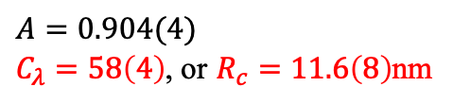
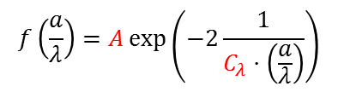
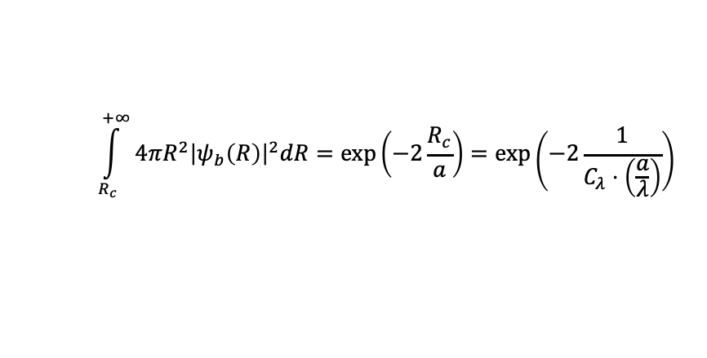
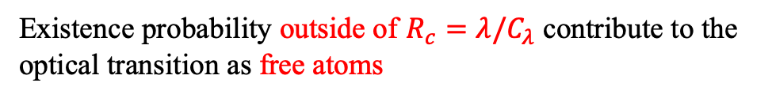

Overlapping ratio between experimental data and the line shape of the free atom
Simple model
Feshbach molecule has a spherical density distribution :
1.0
$$ψ_{b}\left(R\right)=\frac{1}{\sqrt{2πa}}\frac{\exp\left(−R/a\right)}{R}$$
0.9
Existence probability outside of $R_{c}=λ/C_{λ}$ contribute to the optical transition as free atoms
0.8
0.7
$$\int_{R_{c}}^{+∞}{4πR^{2}{\left|ψ_{b}\left(R\right)\right|}^{2}dR}=\exp\left(−2\frac{R_{c}}{a}\right)=\exp\left(−2\frac{1}{C_{λ}⋅\left(\frac{a}{λ}\right)}\right)$$
Overlap ratio
0.6
Atom : |1> and |2>
Mol : |12>
0.5
Mol : |13>
Mol : |23>
$$f\left(\frac{a}{λ}\right)=A\exp\left(−2\frac{1}{C_{λ}⋅\left(\frac{a}{λ}\right)}\right)$$
0.4
Simple model
Fitting function :
Noise level
Experimental noise
0.3
2
4
6
8
2
4
6
8
2
4
6
8
2
0.1
1
10
$A=0.904(4)$
$C_{λ}=58\left(4\right)$, or $R_{c}=11.6\left(8\right)$nm
$$a/λ$$
Fitting result :
Notes:
Here we introduce a simple model.
The Feshbach molecule has a spherical density distribution given by this function.
When we assume that Existence probability outside of $R_{c}=λ/C_{λ}$ contribute to the optical transition as free atoms, this contribution is given by this simple explession.
By considering the experimental noise, we prepare this fitting function with two fitting parameters.
This curve is the fitting result, and the constant value becomes 58.
While this model maches to the data well, physical meaning of the overlapping ratio, validity of this model, origin of this constant must be discussed in the future.

Slide 17
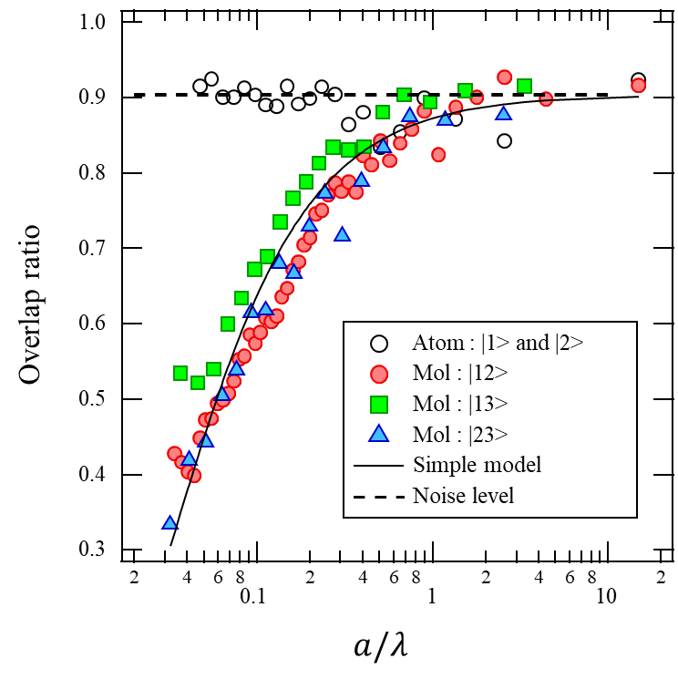
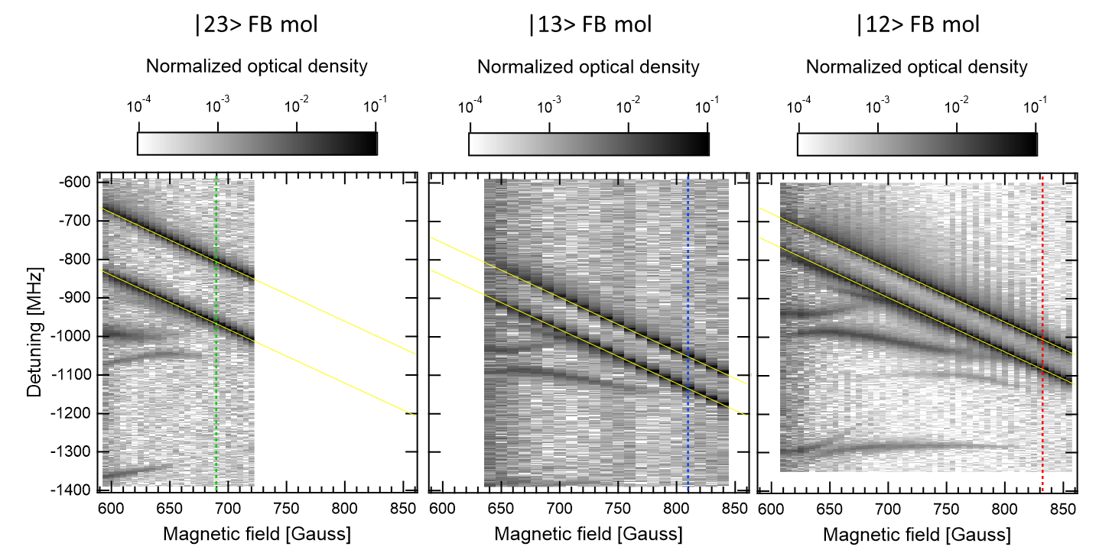
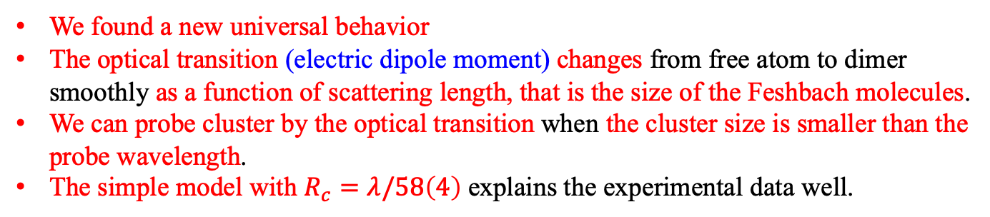
Summary : Universal optical response for Feshbach molecules
Question : How the optical response changes?
What is the condition we can probe the cluster?
Experimental results
We found a new universal behavior
The optical transition (electric dipole moment) changes from free atom to dimer smoothly as a function of scattering length, that is the size of the Feshbach molecules.
We can probe cluster by the optical transition when the cluster size is smaller than the probe wavelength.
The simple model with $R_{c}=λ/58\left(4\right)$ explains the experimental data well.
Future prospects
Physical meaning of the overlapping ratio
Validity of the simple model, universality
Assignment of the exited molecular states, feedback to molecular physics, few-body calculation
Precision measurements of compressibility and viscosity coefficients in the BEC regime in the BCS-BEC crossover
Optical transition of the Efimov trimers
Notes:
This is summary of my talk.
Questions are
How the optical response changes?
And
What is the condition we can probe the cluster?

Slide 19











The molecular potential of Li₂ and the Feshbach molecules
$Li_{2}$molecular potential (at zero magnetic field)
$$(1 {cm}^{−1}=1.4 K)$$
$$(1 {cm}^{−1}=0.12 meV)$$
2s+3p
2p+2p
2s+3s
2s+2p
We can change the size of the Feshbach molecules
$E_{1}$ transition
$${\left\langle d\right\rangle }_{FB}=a(B)$$
e
$$a^{3}Σ_{u}^{+}$$
e
↑
2s+2s
↑
↓
↓
↓
↓
e
↑
↑
↑
e
↑
↑
↑
↓
↓
↓
↓
↓
↓
↓
↓
↓
↓
↑
↑
↑
↑
↑
↑
↓
↑
↓
↑
e
$$X^{1}Σ_{g}^{+}$$
$$R_{vdw}={32a}_{0}$$
e
$$R [a_{0}]$$
$$>1000$$
$$(a_{0}=53 pm)$$
[ P. Jasik and J.E. Sienkiewicz, Chemical Physics 323 (2006) 563–573 ]
Notes:
In order to imagine the length scale of the Feshbach molecules of 6Li, I show you the molecular potential of Li₂.
The interaction range in the ground state is 32 Bohr radius.
However, the size of the Feshbach molecules are much much larger than the interaction range, because the size is equal to the scattering length.
The E1 transition correspond to 2s to 2p transition at the dissociation limit.

